Slide 1
COLD ULMS Decisions
COLD Meeting, San Marcos, February 9, 2017

Slide 2
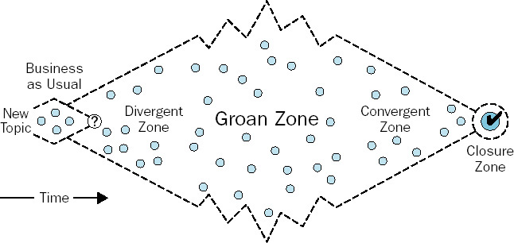
Diamond of Participatory Decision-Making
Sam Kaner: Facilitator’s Guide to Participatory Decision Making

Slide 3
What did we decide already? At the COLD Humboldt Meeting, 10-28-16
The 23 campus libraries agree to pay the full cost of Ex Libris Maintenance Fees for the ULMS without a subsidy from the Chancellor’s Office. In 2017-18, the total cost of Alma and Primo Maintenance will be $1,420,024.
COLD wants to have appropriate voice in determining the job descriptions and job functions of the CO staff who will provide central support for the ULMS.

Slide 4
What do we need to decide today?
A – Cost Share Formula: How do we divide the EL maintenance costs that we agreed to pay between the 23 campuses
B – Central ULMS staffing: What central staffing do we want/need starting in 2017-18 and how do we have appropriate influence on job descriptions and job functions
C – Post Implementation Governance: How will we make decisions about shared policies, procedures, and projects after we go live
D – Initial ULMS Polices: We need to finalize the initial policies that will be implement on day 1 when we go live
Note – We will make decisions today, but the decisions don’t have to be eternal – we need a starting place for 2017-18, but our decisions are subject to revision

Slide 5
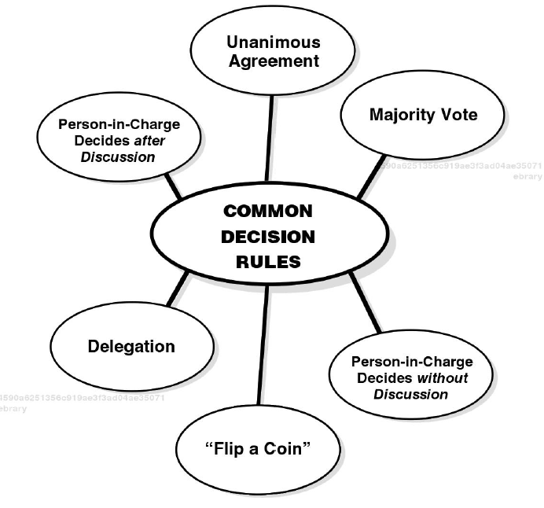
Decision Rules
I suggest majority vote after discussion.

Slide 6
A. Cost Share Formula
Proposal from the cost share task force (Gale, Karen, Mark, Amy)
Use the formula suggested by Dave Walker for one year, and re-visit:
“The Formula column calculates the per-campus cost based on 25% enrollment, 25% collection size, 25% library staff size, and 25% equal division of costs.
The Enrollment, Collection, and Staff columns are taken from AY 2014-15, as this is the most recent year for which we have these statistics. Enrollment numbers are for Fall 2014 and taken from the Chancellor’s Office Analytic Studies Statistical Report. Collection and Staff numbers are taken from CSU Library Statistics Reports (2014-15), Column 1 and Column 13, respectively.”

Slide 7
B. Central ULMS staffing -- Proposals
EC MOU Proposal (John)
Criteria to evaluate shared Staffing (Jen on behalf of 5 COLD members who discussed at ALA)
ULMS Support Proposal from SJSU (Tracy)
Each author will discuss their proposal

Slide 8
C. ULMS Governance
2017-2019 ULMS Governance Proposal (Brandon)

Slide 9
Policies – High Consensus
Eliminate Daily Fines: A=18, D=0, ND=1
One year loan faculty/staff: A=16, D=0, ND=2
Semester Loan for Students: A=18, D=0, ND=1
Collection Development for shared e-resources: A=15, D=0, ND=3

Slide 10
Polices Lower Consensus
Default replacement cost - $115: A=12, D=0, ND=7
Unified Discovery System Name (OneSearch): A = 12, D = 0, ND = 7
Resource Sharing Policy Recommendations: A = 10, D = 1, ND = 8

