Slide 1
Resource Sharing and Fulfillment
California State University | January 11, 2017
MEGAN DRAKE | IMPLEMENTATION CONSULTANT

Slide 2
Resource Sharing

Slide 3
Peer to Peer Resource Sharing in Alma
Alma interacts directly with the lending/borrowing institutions to provide/get the resource
Requires no patron data sharing agreements
Lending policies are handled by each library
Title-level requesting allows for multiple partners to fulfill the request
Pickup/Return at your home institution.

Slide 4

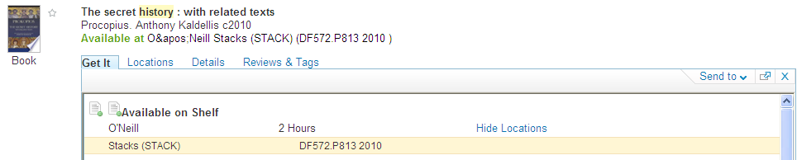


Peer to Peer Resource Sharing in Alma
Search
Calculate Services
Submit
Request
Institution C
Institution B
Supplier of Last Resort
Request from Peers

Slide 5

Peer-to-Peer Resource Sharing: Data Elements
Network Zone
Members
Partner
Locate & Workflow Profile
Borrower Institution
Integration Type
Partner
Locate & Workflow Profile
Integration Type
Borrower Institution
Partner
Locate & Workflow Profile
Integration Type
Borrower Institution

Slide 6
Rota: Who Can Get This For Me?
Rota Template 1
Rota Template 2
Partner 1
Partner 5
Partner 2
Partner 6
Partner 3
Partner 7
Partner 4
Partner 8
Notes:
I may arrange my partners in rotas

Slide 7
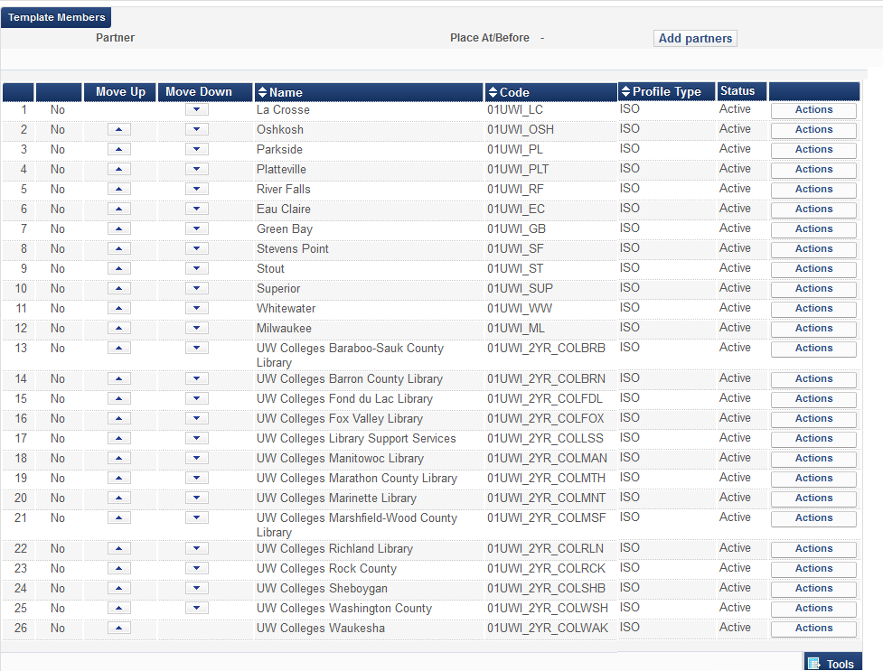
Rota: Who Can Get This For Me?

Slide 8


Rota: Who Can Get This For Me?
Partner 1
P2P Partner 1
Partner 2
P2P Partner 2
P2P Partner 3
Partner 3
Partner 4
P2P Partner 4
Partner 5
P2P Partner 5
Partner 6
P2P Partner 6
Partner 7
P2P Partner 7
P2P Partner 8
Partner 8

Slide 9
Lending String: Who Can Get This For Me?
Partner 2
P2P Partner 2
P2P Partner 3
Partner 3
Partner 5
P2P Partner 5
Partner 7
P2P Partner 7
Notes:
Lending String

Slide 10
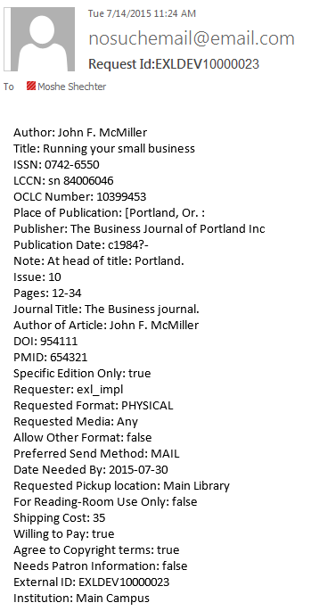




ILLiad as Partner of Last Resort

Slide 11
Can You Get This For Me ?
Request
Ship
Receive
Borrower Institution
Lender Institution
Return
Check In

Slide 12
Can You Get This For Me ?
Reject
Overdue
Will Supply
Expire
General Message
Borrower Institution
Lender Institution
Recall
Renew / Renew Response
Cancel / Cancel Response

Slide 13
Typical Peer-to-Peer Resource Sharing Workflow
A patron submits a resource request to his home institution.
The home institution automatically locates the best potential supplier, according to the institution’s priorities and considerations.
The home institution receives an item from the lending library.
The lending library holds the patron’s home institution responsible for the loaned resource.
The home institution manages a standard loan lifecycle with the requesting patron, until the item is eventually returned and sent back to the lending library.

Slide 14
Peer-to-Peer Resource Sharing
How does it look in Alma?

Slide 15
Walk-In Patrons

Slide 16

Walk-in Patrons
Patron of Institution B wants to get services at a Institution A desk, for an Institution A resource
Lookup/Search
Share
Patrons with
A
B
Service
Patrons of
[Home Institution]
John Smith
[Visitor]
John Smith
Patron @ A
Patron @ B

Slide 17




Walk-in Patrons
Rules define how the patron will be copied over :
User Group
Resource Sharing Library
Expiry Date
Purge Date
Institution A
Institution B

Slide 18
Walk-in Patrons
How does it look in Alma?

Slide 19
Miscellaneous Fulfillment

Slide 20
Reminder: Basic Components
Fulfillment units group locations and apply Terms of Use
Terms of Use group polices into a reusable unit
Fulfillment Unit
Terms of Use
Terms of Use
Policy
Policy
Policy
Policy
Policy
Policy
Notes:
Fulfillment units are defined as groups of locations with common policies—loan and request. Fulfillment policies themselves are grouped into ToU and bound to the collection via these fulfillment units.

Slide 21
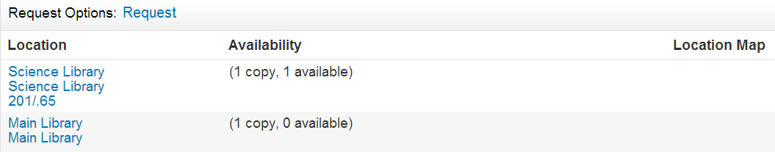
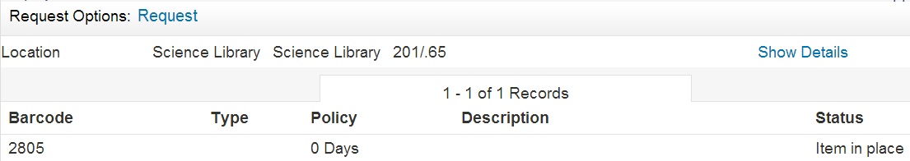
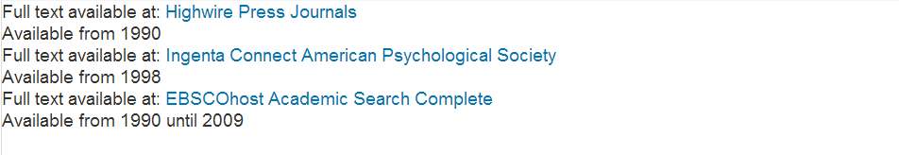
Link Resolver View Of Inventory
Get It (physical)
View It (electronic)
Holdings
Item summary
Item list
Portfolios
E-collection names
Notes:
So what does the inventory model look like in Primo? There are two tabs that users can see in Primo, one for physical resources and one for electronic.
For physical resources, users will see a tab called Get It. At the top, as in this example, they’ll see the option to request and below is the actual inventory available for this resource.
[Click] Each line is a unique line for holdings, and then there’s an [Click] item summary with an availability look-ahead to determine whether the item is available at this location.
For more detail, you can click on a holdings link and see the item list [Click]. This view contains the item barcode, the loan policy (in this example, the item doesn’t loan), and the status.
[Click] For electronic resources, there’s a tab called View It with a services menu that has information on what portfolios are available.
You’ll see in this example that there are 3 different lines for each package that the title is available in, along with coverage information.
[Click] The highlighted link is the package name (or in Alma terms, it’s the electronic collection name.)
This is what users will see in Primo in terms of actual delivery: ability to drill down and see information about the inventory, and ability to link directly to the titles as available through various packages.

