Slide 1
Working with the Alma Community Zone and Electronic Resources
Yoel Kortick
Senior Librarian

Slide 2
Agenda
Introduction
Managing Electronic Inventory
Types of in the Community Zone
Knowledge Base Updates
Community Zone Updates Task List
Electronic Resource Activation Task List

Slide 3
Introduction
Alma Inventory Model
Before beginning our discussion we must first understand the Alma Inventory model and how it relates to
The Community Zone
The Institution Zone

Slide 4
Introduction
Community Zone
The Alma Community Zone (CZ) is a shared repository for all Alma users.
It includes
Authority records
Bibliographic metadata
An electronic materials knowledge base
known as the “CKB”

Slide 5
Introduction
Community Zone Components
Community Catalog
Bibliographic records describing electronic resources
In the future will also include print
Central Knowledgebase (Electronic inventory)
Electronic Collections of electronic resources offered by vendors, with linking information and individual titles in the Electronic Collections
Global Authorities
Authority files currently including LC names and subjects, MESH and GND from Deutsche Nationalbibliothek

Slide 6
Introduction
Institution Zone
The Institution Zone (local catalog) contains local bibliographic records created, copied or imported locally by the institution
The inventory is linked to the MMS record (Metadata Management System record)
The publishing process (for example to Primo) provides a means for the user to access the inventory

Slide 7
Introduction
Types of Inventory
The Institution Zone inventory contains all locally acquired material by the institution, including:
Physical = Items and holdings
Electronic = Electronic Collections and portfolios
Digital = Representations and files
It is the sum of all resources acquired and managed by the institution and made available to patrons
The resources may link to the Institution Catalog (Zone) or to the Community Catalog (Zone)

Slide 8
Introduction
Community Zone
Institution Zone
Global Authorities
Shared repository of standard authority files
Institution Catalog
Descriptive records managed by your institution
Community Catalog
Shared records managed by ExL
Currently e-resources
Local Inventory
Can link to the Institution, Network, or Community Catalog
Defines what resources (across all catalogs) are managed by your library
Central KnowledgeBase
Shared administrative information for e-resources

Slide 9
Agenda
Introduction
Managing Electronic Inventory
Types of Electronic Collections in the Community Zone
Knowledge Base Updates
Community Zone Updates Task List
Electronic Resource Activation Task List

Slide 10
Managing Electronic Inventory
The process of managing electronic inventory via the CZ starts by activating or ordering an aggregator or selective electronic collection from the CZ. This
Creates a local (in the institution) inventory record
A local copy of a bibliographic record which is linked to the CZ
Following this any time a change is made to the inventory or the bibliographic record in the CZ it will also automatically be reflected in the Institution.
The next slides will show this

Slide 11
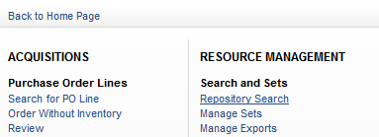
Managing Electronic Inventory
The library searches the Community Zone

Slide 12
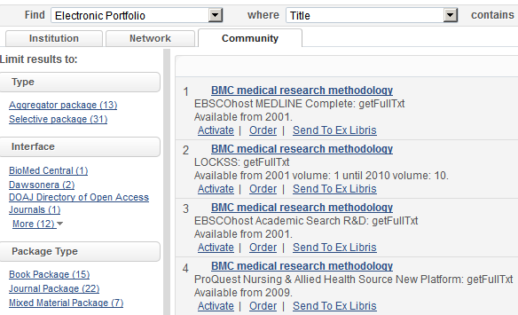
Managing Electronic Inventory
The results include aggregator and selective Electronic Collections (in this case portfolios in the electronic collection)
The library activates a resource

Slide 13
Managing Electronic Inventory
As soon as the record is activated a copy of it exists in the Institution Zone with a link to Community Zone
The icon next to the record means that it belongs to the Community Zone.
Clicking it brings the user to the Community Zone

Slide 14
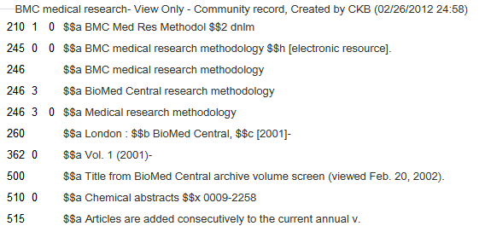
Managing Electronic Inventory
A copy of the bibliographic record exists in the institution but it belongs to the Community Zone* and any updates are done in the Community Zone
* Updates to the Community Zone are done by Ex Libris data services

Slide 15
Managing Electronic Inventory
A link to the electronic inventory of the title also exists in the Institution Zone

Slide 16
Managing Electronic Inventory
Now if the bibliographic record or the inventory information changes it will automatically be updated in the Community Zone and reflected in the Institution Zone
This
Saves valuable time for the librarians
Ensures that data is always up to date

Slide 17
Agenda
Introduction
Managing Electronic Inventory
Types of Electronic Collections in the Community Zone
Knowledge Base Updates
Community Zone Updates Task List
Electronic Resource Activation Task List

Slide 18
Types of Electronic Collections in the Community Zone
The Community Zone includes two types of Electronic Collections:
Aggregator
Typically activated at the electronic collection level.
Selective
Typically used to selectively activate a list of titles from the electronic collection

Slide 19
Types of Electronic Collections in the Community Zone
For aggregator and selective Electronic Collections it is possible to define that new portfolios will automatically be added to the local inventory when they are added to the electronic collection in the Community Zone.
Here we click ‘Activate’, in this case for an aggregator electronic collection

Slide 20
Types of Electronic Collections in the Community Zone
As part of the activation wizard the staff user can choose “Automatically activate new portfolios”

Slide 21
Agenda
Introduction
Managing Electronic Inventory
Types of Electronic Collections in the Community Zone
Knowledge Base Updates
Community Zone Updates Task List
Electronic Resource Activation Task List

Slide 22
Knowledge Base Updates
Every Sunday weekly updates are loaded to the KB
Each institution which activated Electronic Collections in the KB will automatically get the updates notifications via The Community Zone updates task list
The Community Zone task list was developed to allow libraries to view the changes and in some case take further actions.

Slide 23
Knowledge Base Updates
In each institution the job “Synchronize Changes from CZ” runs and creates the necessary changes based on the specific inventory of the institution.

Slide 24
Knowledge Base Updates
The changes which occur in the KB are of two types:
Changes done for all electronic collection types
electronic collection base URL updates
electronic collection linking parameters updates
Portfolio coverage updates
electronic collection service deletions
electronic collection deletions
Changes done for auto-activate Electronic Collections
Portfolio added
Portfolio deleted

Slide 25
Agenda
Introduction
Managing Electronic Inventory
Types of Electronic Collections in the Community Zone
Knowledge Base Updates
Community Zone Updates Task List
Electronic Resource Activation Task List

Slide 26
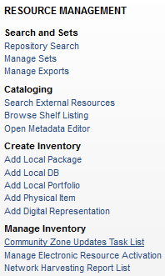
Community Zone Updates Task List

Slide 27
Community Zone Updates Task List
The Community Updates Task List has two tabs:
Review
Default
Includes changes to the institutions' records and changes which library may want to take action on
All
Changes which are listed for general information

Slide 28
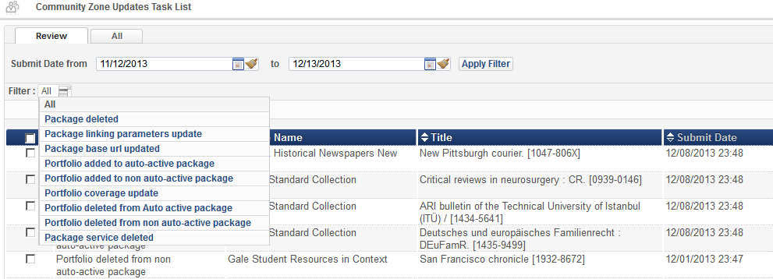
Community Zone Updates Task List
The types of changes included may be filtered

Slide 29
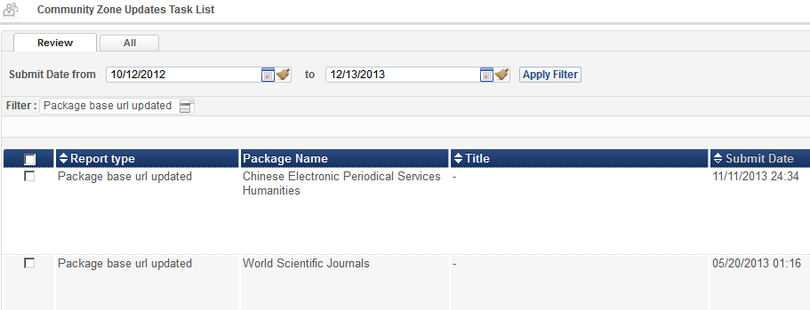
Community Zone Updates Task List
Here for example in the “Review” tab we have filtered for “electronic collection Base URL updated”

Slide 30
Community Zone Updates Task List
For the first case of electronic collection name we can see that the change is that the URL changed from http://www.airitilibrary.com./pubissue.aspx?PublicationID= to www.airitilibrary.com/Publication/alPublicationJournal?PublicationID=

Slide 31
Community Zone Updates Task List
The change is reflected in the electronic collection.
The change is automatically made

Slide 32
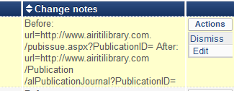
Community Zone Updates Task List
To keep the change and move on we choose “Dismiss”
The record will then be removed from the “Review” tab of the Community Zone Updates Task List

Slide 33
Community Zone Updates Task List
To revert the change choose “Edit”
For example you can copy the old URL, click edit, and then you are in the electronic service editor.
The old URL may be entered to override the new URL

Slide 34
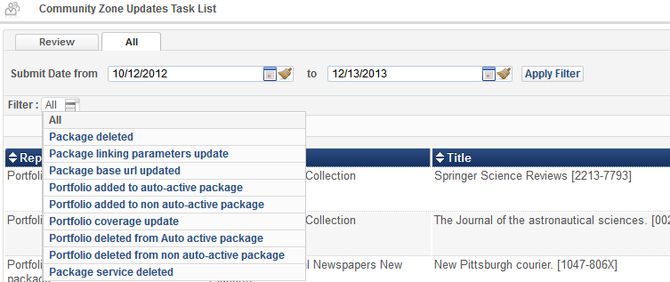
Community Zone Updates Task List
Now we return to the Community Zone Updates Task List and choose the “All” tab
Here we will see how titles are added to auto-active and non auto-active Electronic Collections.

Slide 35
Community Zone Updates Task List
Reminder: Thus is where we defined if a electronic collection is an “auto-active electronic collection”.

Slide 36
Community Zone Updates Task List
On the next slide we will see Task List filtered by results for “Portfolio added to auto-active electronic collection”.
This is a list of portfolios that were already added to your Electronic Collections.
No options are available because the action already took place

Slide 37
Community Zone Updates Task List
Let’s look at the first example for Title “International Journal of New Computer Architectures & their Applications” which was added to electronic collection “Gale Cengage Computer Database”

Slide 38
Community Zone Updates Task List
If we search for it in our institution we see that we have it, there is an icon indicating that it was activated from the Community Zone, and it is in electronic collection Gale Cengage Computer Database

Slide 39
Community Zone Updates Task List
If we click the icon to view the title in the Community Zone and then click “Portfolio List”…

Slide 40
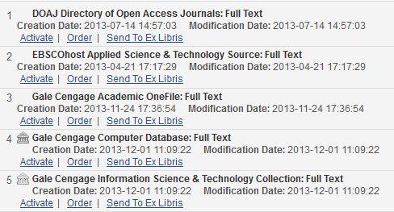
Community Zone Updates Task List
We see that the portfolio “International Journal of New Computer Architectures & their Applications” which was added to electronic collection “Gale Cengage Computer Database”
The update was done on 2013.12.01

Slide 41
Community Zone Updates Task List
This is the same date we saw in the Community Zone Updates Task List
CZ Updates Task List
CZ Search

Slide 42
Community Zone Updates Task List
Now we return to the Community Zone Updates Task List and this time choose “Portfolio added to non auto active electronic collection”
There is no action to perform, and no change has been made because the electronic collection is non auto-active
The information provided consists of titles added to the electronic collection in case the librarian will want to manually add the titles to the electronic collection

Slide 43
Community Zone Updates Task List
For example here we see that title “Revista Exodus” was added to the electronic collection “Free E-Journals”
The title is currently not in the institution. As we stated no action was done for non auto-active.

Slide 44
Community Zone Updates Task List
But we can go to the Community Zone, find the title and order or activate it.
As states in the Updates Task List it was added to the electronic collection “Free E Journals”

Slide 45
Agenda
Introduction
Managing Electronic Inventory
Types of Electronic Collections in the Community Zone
Knowledge Base Updates
Community Zone Updates Task List
Electronic Resource Activation Task List

Slide 46
Electronic Resource Activation Task List
After an electronic resource has been added to the inventory there are other tasks that may need to be completed prior to making the resource visible to patrons.
For example, the library may want to test access to the e-resource to confirm that the access is working properly.
In Alma, these tasks are handled through the options provided by the Electronic Resource Activation Task List

Slide 47
Electronic Resource Activation Task List
Resources are added to the ‘Electronic Resource Activation Task List’ automatically if they are ordered from the Community Zone.
They are not automatically added to the Electronic Resource Activation Task List if the “Activate” option is used from the Community Zone search results without using the “Order” process.

Slide 48
Electronic Resource Activation Task List
Additionally, resources may be added to the ‘Electronic Resource Activation Task List’ by clicking “Create E-Activation task” from the Electronic Portfolio search results in the institution repository search.

Slide 49
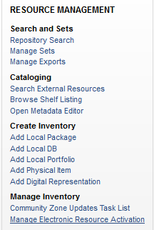
Electronic Resource Activation Task List

Slide 50
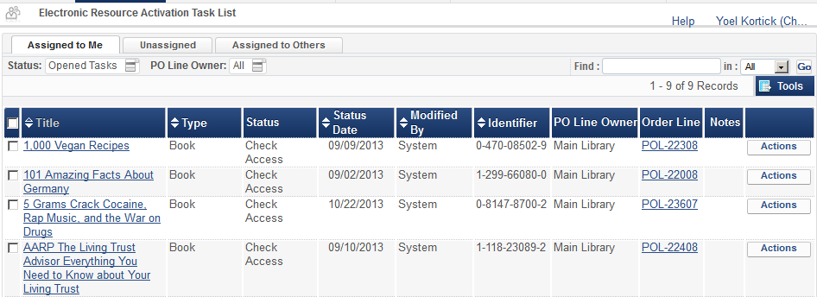
Electronic Resource Activation Task List

Slide 51
Electronic Resource Activation Task List
Now we search the CZ and click “Order”
The order is created

Slide 52
Electronic Resource Activation Task List
It appears in Institution Zone with link to Community Zone

Slide 53
Electronic Resource Activation Task List
The resource is not available yet

Slide 54
Electronic Resource Activation Task List
It automatically appears in the Electronic Resource Activation Task List
By default the task will be in the “Unassigned” tab and will be then be assigned to the first user who performs an action on it

Slide 55
Electronic Resource Activation Task List
From here multiple activities may be performed on the resource
We will choose ‘Activate’
For details of each Action activity see online help: Inventory > Managing Electronic Resources > Activating Electronic Resources > Managing Electronic Resource Activation

Slide 56
Electronic Resource Activation Task List
We confirm resource activation
We will choose ‘Activate’

Slide 57
Electronic Resource Activation Task List
Now the resource is available

Slide 58
Thank You

