Slide 1
LMS Integration Options
COLD, Stanislaus
November 30, 2017
John Wenzler, CSUEB

Slide 2
Library/LMS Integration
Why?
Why not?
How?

Slide 3
Why?
Increase usage of Library Resources
Affordable Learning Solutions
Metrics/Data – Learning Analytics
Collaboration

Slide 4
Increase Usage
LMS becoming home page for students/faculty
Explicit faculty endorsement
Library can provide curated course-specific resources
Advocacy/support of LMS Instructional Designers

Slide 5
NBC Learn Usage CSUEB 2016/17
Total LMS = 1,050
Total Non-LMS = 112

Slide 6

Affordable Learning Solutions
Make it easier for Instructors to assign library stuff as required reading – reduces student costs
CSU AL$ Project

Slide 7
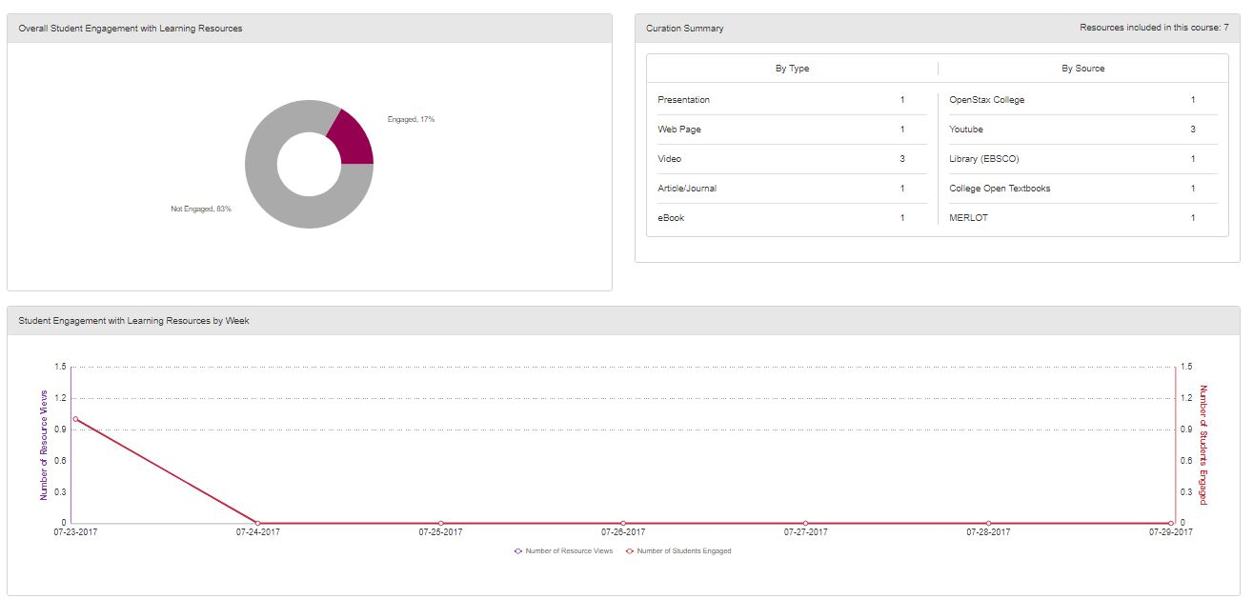
Metrics – promises of Learning Analytics
Collection Development – course level, student level usage reports
Demonstrate specific library contributions to student success
“triangulate library data” COLD Strat plan

Slide 8
Collaboration
Embedded Librarians
Learning Management System/Instructional Designers
Bookstore
Student Success Initiatives

Slide 9
Why Not?
Privacy – the other side of Learning Analytics: COLD Student Data Privacy Resolution (interesting book: Weapons of Math Destruction)
Workload/Workflows – How much time should libraries spend on LMS integration and who should do it? Scalability issues. Three options:
  Library employees add library stuff to the LMS
  Library entices instructors to add library stuff to the LMS
  Some kind of automated solution (harder for ALS)

Slide 10
How?
DIY
Intellus (acquired by Macmillan Learning)
LibGuides LTI Tool (Springshare)
Leganto (Ex Libris acquired SIPX)

Slide 11
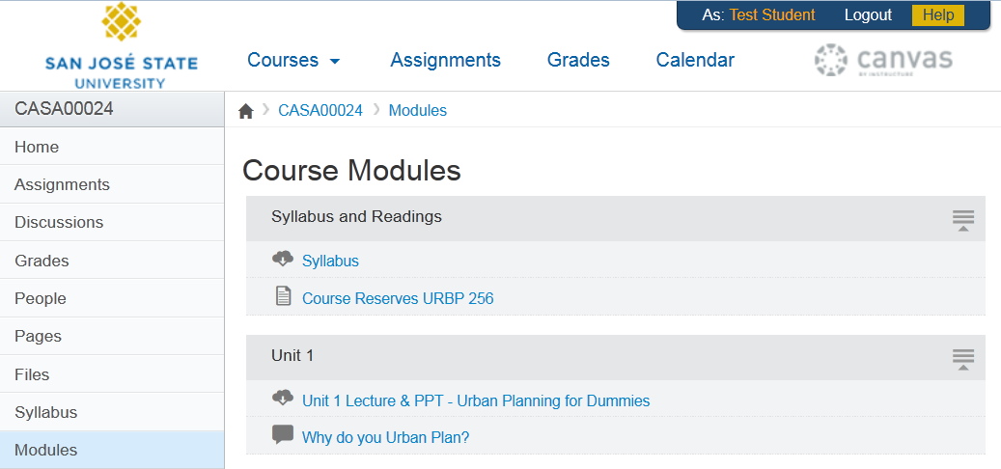
DIY -- SJSU Canvas Project

Slide 12
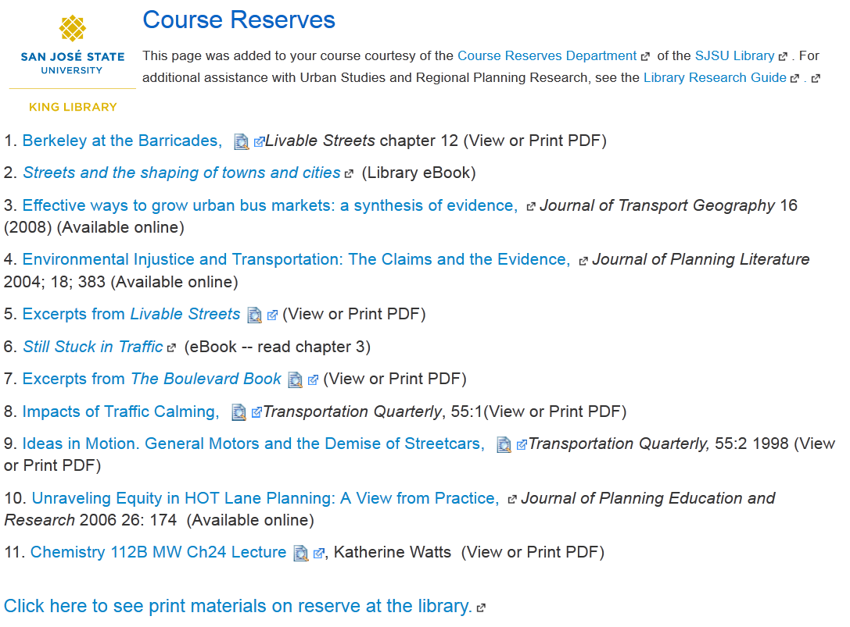
Branding
Library Database
eBook
Scanned Article

Slide 13
DIY – Pros & Cons
Pros
Flexibility
Control
No additional Software Costs
Opportunity for engagement
Cons
Scalability
Maintenance?
Do we want solutions for every class on campus?
Do we want a CSUwide solution?

Slide 14
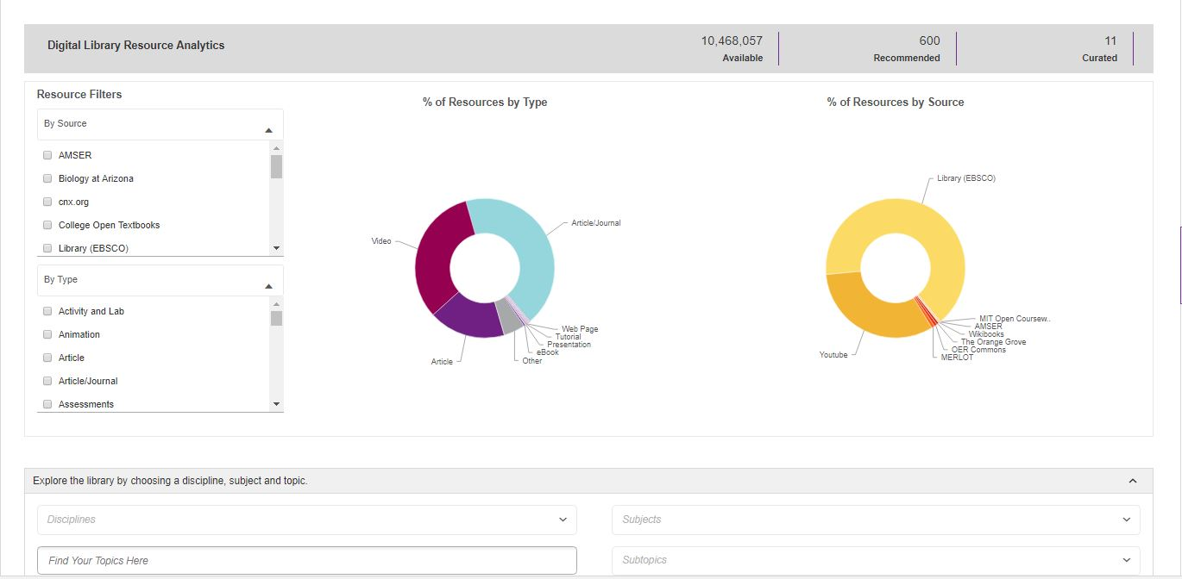
Intellus OER Database
Notes:
Platform URL:Platform URL: http://csu-eastbay-arp.intelluslearning.com/ Login: john.wenzler@csueastbay.edu Password: john.wenzler648

Slide 15
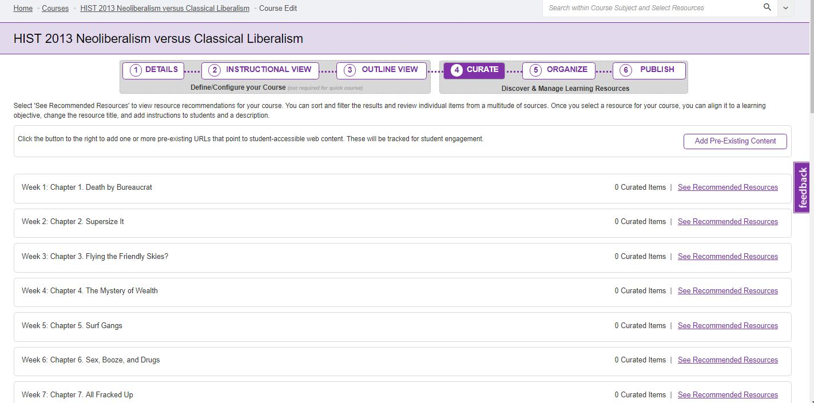
Intellus Faculty View
CSU LibIT Meeting
Chico, 8/1/17
Wenzler
Notes:
Platform URL:Platform URL: http://csu-eastbay-arp.intelluslearning.com/ Login: john.wenzler@csueastbay.edu Password: john.wenzler648

Slide 16
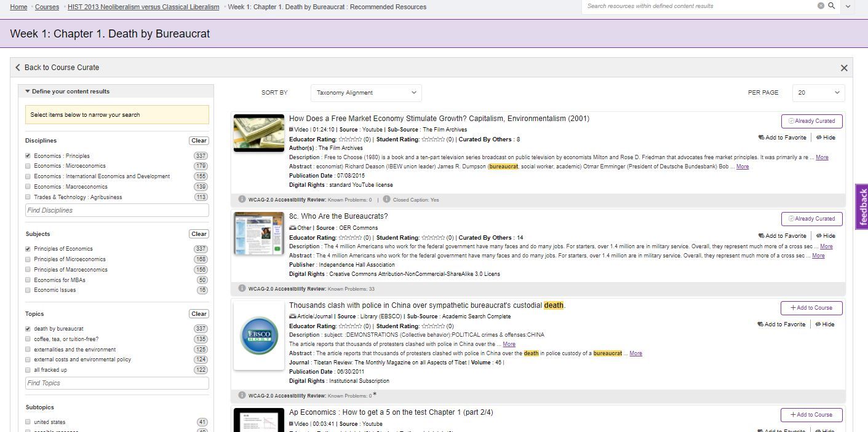
Intellus Faculty View
CSU LibIT Meeting
Chico, 8/1/17
Wenzler
Notes:
Platform URL:Platform URL: http://csu-eastbay-arp.intelluslearning.com/ Login: john.wenzler@csueastbay.edu Password: john.wenzler648

Slide 17
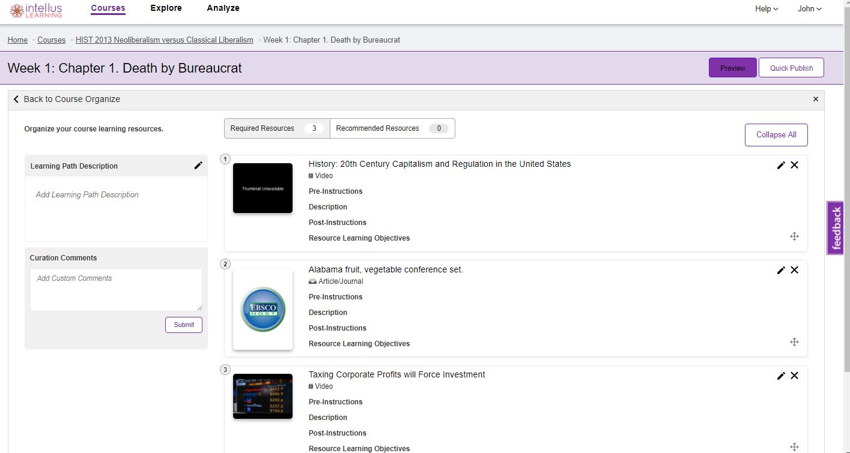
Intellus Faculty View
Notes:
Platform URL:Platform URL: http://csu-eastbay-arp.intelluslearning.com/ Login: john.wenzler@csueastbay.edu Password: john.wenzler648

Slide 18
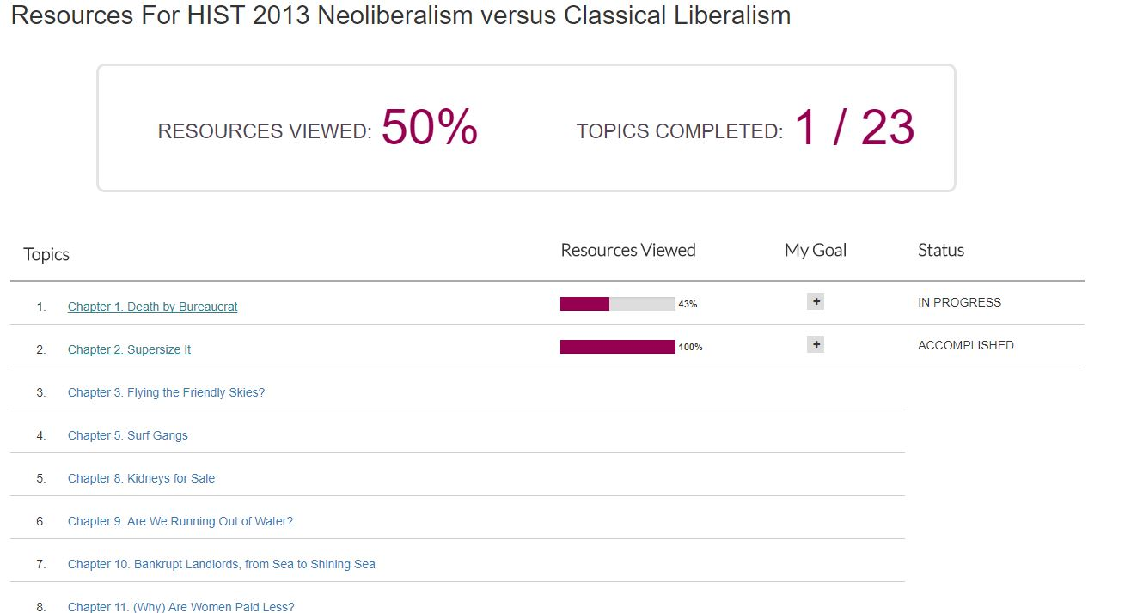
Intellus Student View
Notes:
Platform URL:Platform URL: http://csu-eastbay-arp.intelluslearning.com/ Login: john.wenzler@csueastbay.edu Password: john.wenzler648

Slide 19
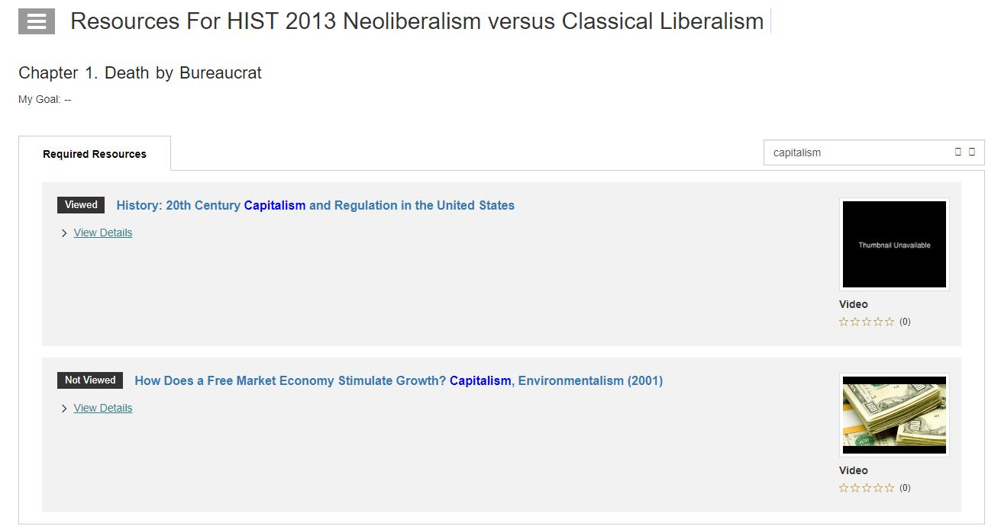
Intellus Student View
Notes:
Platform URL:Platform URL: http://csu-eastbay-arp.intelluslearning.com/ Login: john.wenzler@csueastbay.edu Password: john.wenzler648

Slide 20
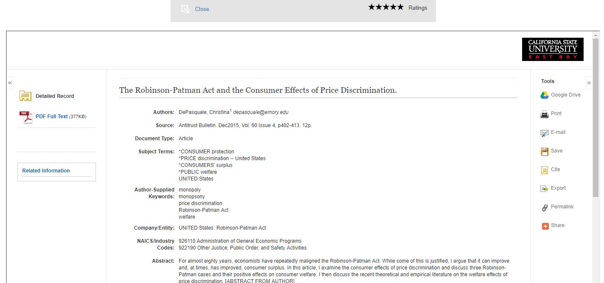
EBSCO in Intellus
Tools embedded in Intellus/LMS, but no searching for other stuff
CSU LibIT Meeting
Chico, 8/1/17
Wenzler
Notes:
Platform URL:Platform URL: http://csu-eastbay-arp.intelluslearning.com/ Login: john.wenzler@csueastbay.edu Password: john.wenzler648

Slide 21
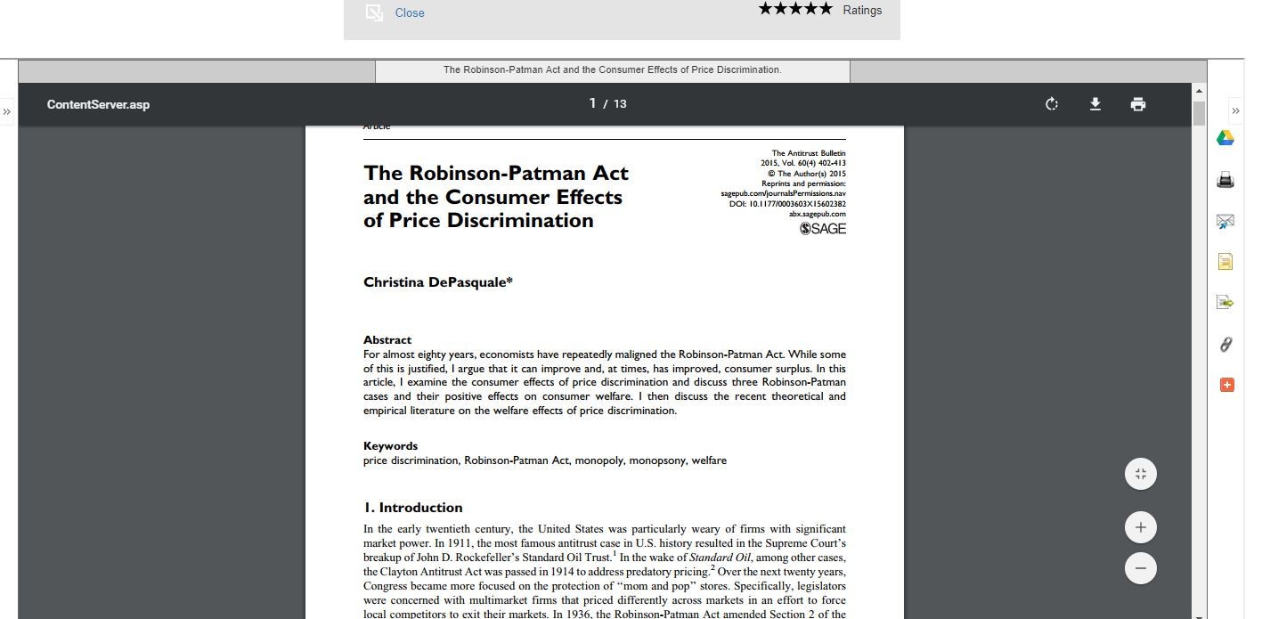
EBSCO in Intellus
Go Back to your course
Notes:
Platform URL:Platform URL: http://csu-eastbay-arp.intelluslearning.com/ Login: john.wenzler@csueastbay.edu Password: john.wenzler648

Slide 22
Intellus – Pros & Cons
Pros
Finds material based on existing textbooks
Nice Student interface
Lots of bells and whistles based on online instructional design
Granular data on usage
Cons
Too much work for Faculty – at Fresno, 10% or less of faculty who were trained actually used Intellus in a class
Is it really effective to include library content in their index and search tool

Slide 23
Fresno’s Intellus Experiment
Integrate Intellus with Sidewalk Hero: http://www.gosidewalk.com/hero/
Instructors have to submit reading list to Bookstore through Hero
Hero tells them exactly how much their students will have to pay, and asks if they want to look for less expensive options through Intellus
Content selected in Intellus automatically loaded into BlackBoard (I don’t know how)

Slide 24

Springshare LibApps LTI
LTI (Learning Tools Integration) – a protocol for integrating with any LMS. (Intellus & Leganto use it too)
Per Springshare, LibApps LTI “is the ‘Holy Grail’ for librarians.”

Slide 25
LibApps LTI
Included with LibGuides CMS subscription
Manually embed guides or content boxes, course by course
Or two automated options:
  Embed guides in matching courses (using metadata in guides)
  Create “Library LTI” page that gets embedded in every course with matching guides and other Springshare stuff (A-Z list, LibAnswers, LibCal…)
Optional E-reserves module (extra cost)

Slide 26
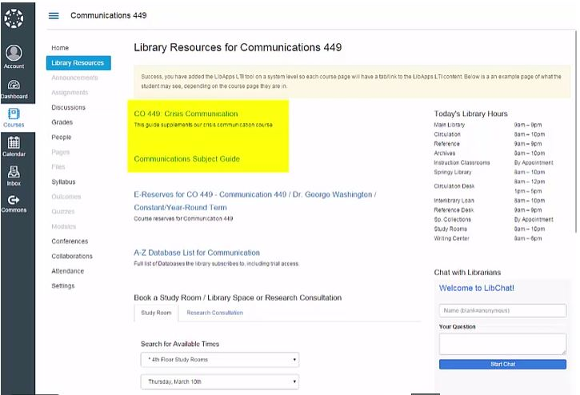
LibApps LTI
See Springshare Video*
http://buzz.springshare.com/producthighlights/whylgcms/lti
Canvas Example: Library Resources link in every course
* I didn’t get our test set up in time

Slide 27
LibApps LTI – Pros & Cons
Can add different types of content, not just reading lists
Minimal additional work for the library (it is not necessary at least …)
Springshare generally is low cost and provides good support
E-reserves is an added module – may be less sophisticated than other options – both for adding content and analytics

Slide 28

Lenganto
A big, giant,
honking thing …

Slide 29
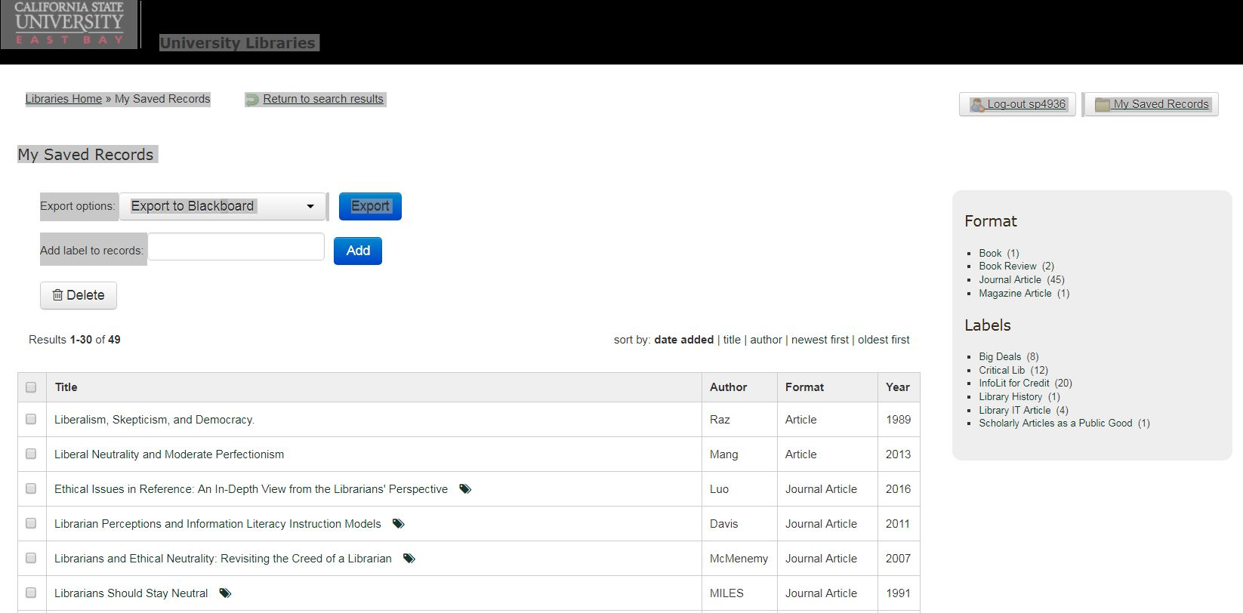
The world we have lost …

Slide 30
Leganto
Integrated with PeopleSoft (or LMS) for Courses and Users
Integrated with Alma for library staff maintenance (reserves, digitization on demand, purchase …)
Integrated with SIPX for Copyright clearance, and article pay for view options for students
“Cite It” Bookmarklet so that you can get citations from Amazon, Google, etc.
BlackBoard View
Alma Library Staff View
Notes:
Login : leganto_instructor Password : @pple1 Login : leganto_student Password : @pple1 Login: leglibr1 Password : LegLibr1

Slide 31
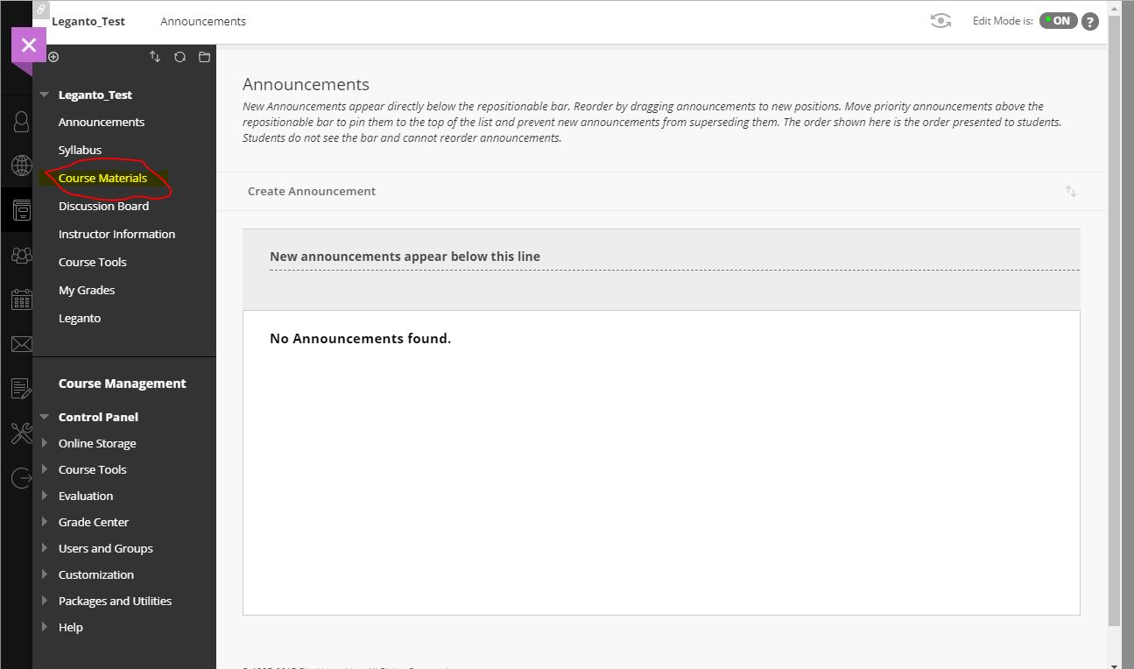
Leganto -- BlackBoard
Click here to get to Leganto
Notes:
Login : leganto_instructor Password : @pple1 Login : leganto_student Password : @pple1 Login: leglib1 Password : LegLib1

Slide 32
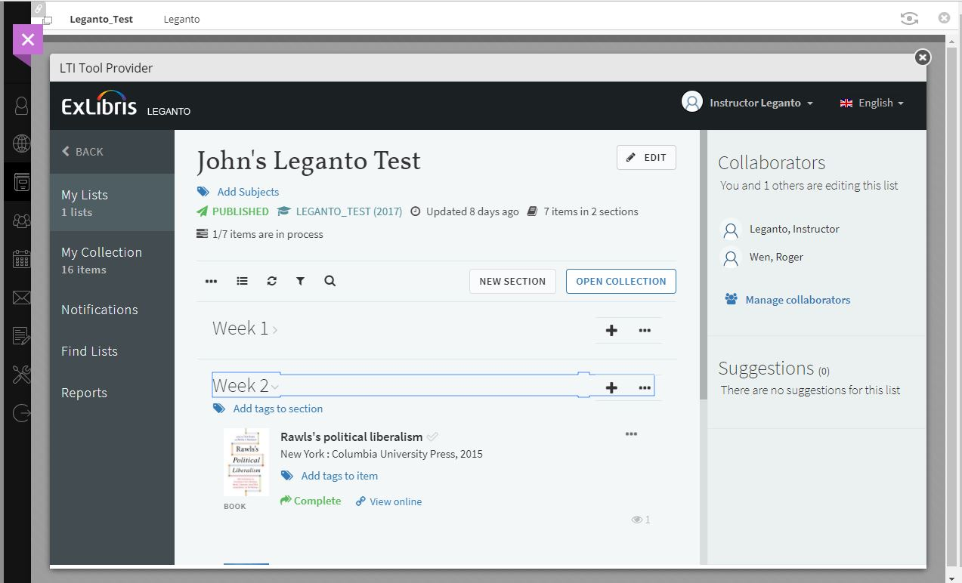
Leganto -- BlackBoard
Search Primo from LMS
Notes:
Login : leganto_instructor Password : @pple1 Login : leganto_student Password : @pple1 Login: leglib1 Password : LegLib1

Slide 33
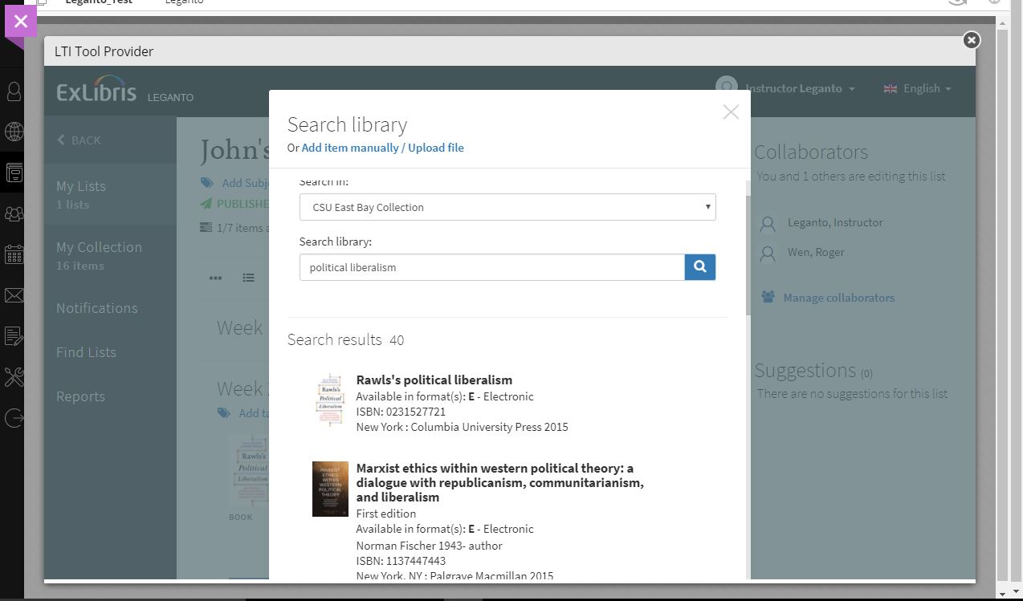
Leganto -- BlackBoard
Your Primo Scopes – Advanced Search available too
Or upload stuff
Notes:
Login : leganto_instructor Password : @pple1 Login : leganto_student Password : @pple1 Login: leglib1 Password : LegLib1

Slide 34
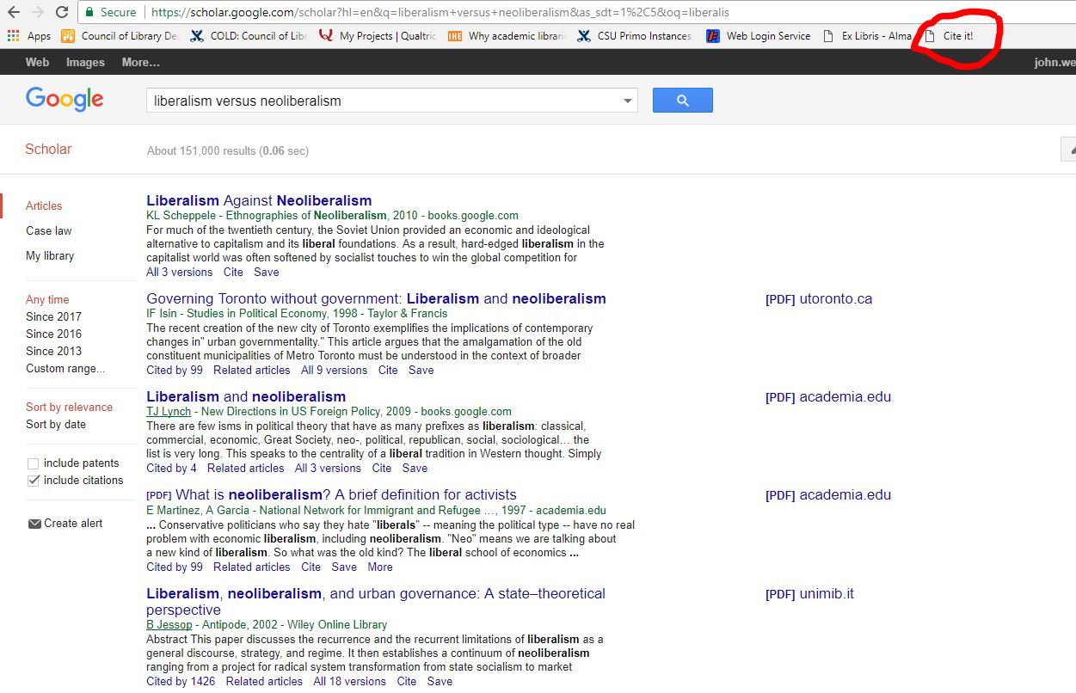
Leganto – Cite It
Notes:
Login : leganto_instructor Password : @pple1 Login : leganto_student Password : @pple1 Login: leglib1 Password : LegLib1

Slide 35
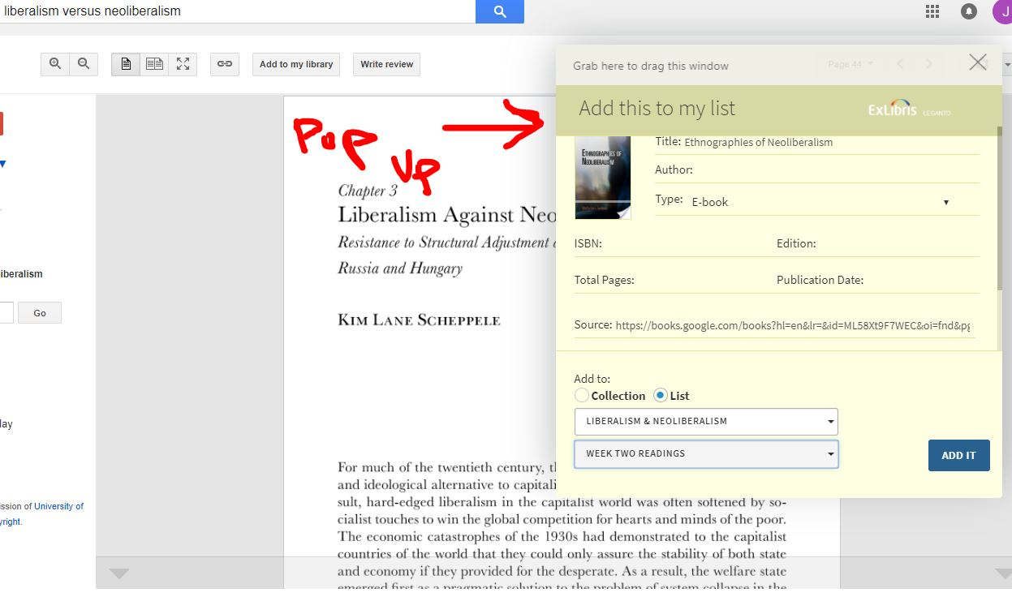
Leganto – Cite It
Notes:
Login : leganto_instructor Password : @pple1 Login : leganto_student Password : @pple1 Login: leglib1 Password : LegLib1

Slide 36
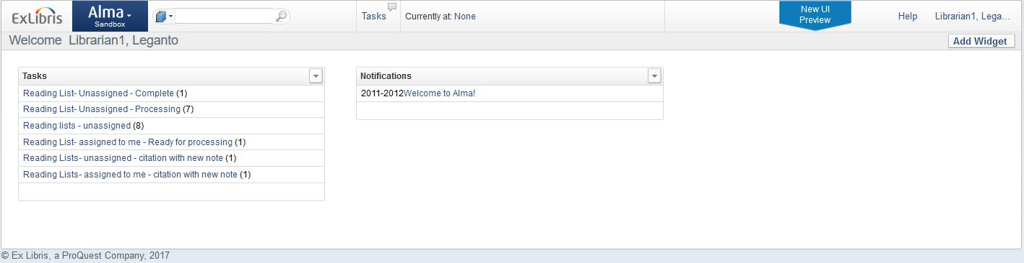
Leganto – Alma View
Notes:
Login : leganto_instructor Password : @pple1 Login : leganto_student Password : @pple1 Login: leglib1 Password : LegLib1

Slide 37
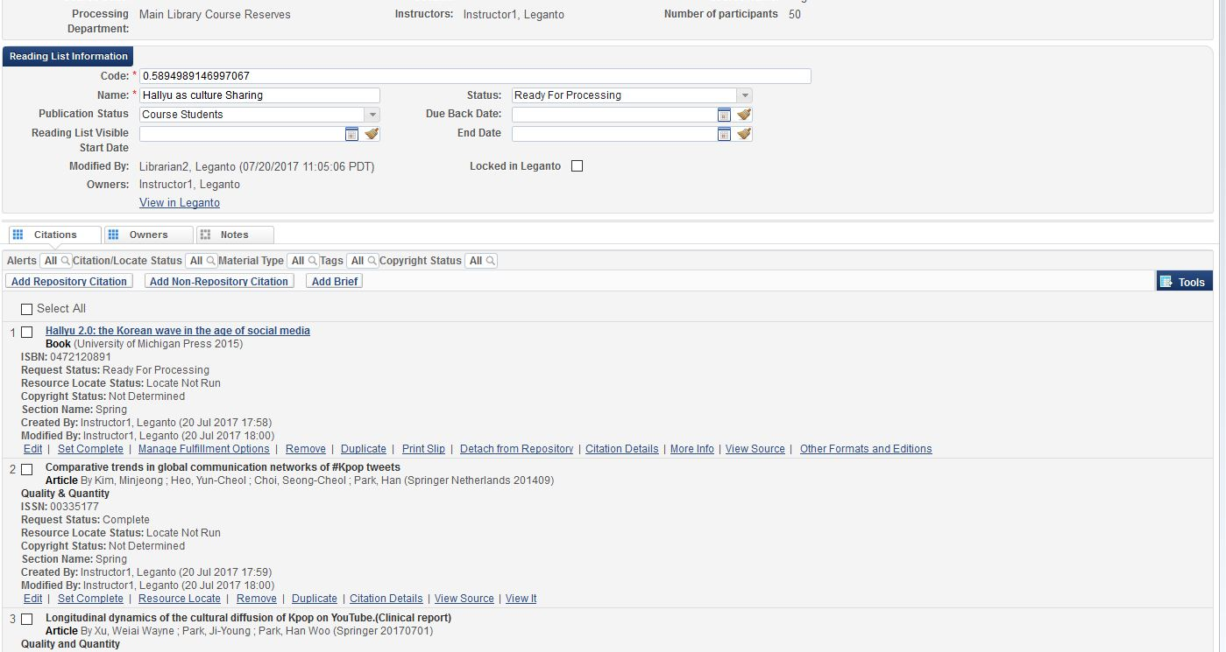
Leganto – Alma View
Notes:
Login : leganto_instructor Password : @pple1 Login : leganto_student Password : @pple1 Login: leglib1 Password : LegLib1

Slide 38
Leganto – Pros & Cons
Pros
All kinds of integration …
Potential for the library to give much broader reserves services (digitization, pay per view, options)
Potential savings for students w/o copyright violations
Good Learning Analytics statistics
Nice interface for instructor and student – Primo in the middle of LMS
Cons
Re-thinking reserves means new workflows, and probably more work
Lots of moving parts
How much will faculty do; how much library and instructional designers do?
Cost of licensing, cost of paying for articles on demand (if you chose to do so)

Slide 39
Lenganto Workflow expectations
EL’s Assumed Workflow
Instructors create their reading lists in Lenganto
Library staff curate the lists in Alma
John’s Cynical Workflow Prediction
Instructors hand reading lists to the library
The library does everything else
(If so, how does Lenganto differ from SJSU’s DIY solution …)

